Slide 1
Design and Implementation of High-Performance FIR Filter for Real-Time Audio Signal Processing
-With Comprehensive Static Timing Analysis
2310040023-Yasaswini
2310040072-Akshaya
2310049146-Kashifa

Slide 2
Problem Statement
Problem Statement: Design a high-performance, resource-efficient FIR digital filter for real-time audio signal processing applications.

Slide 3
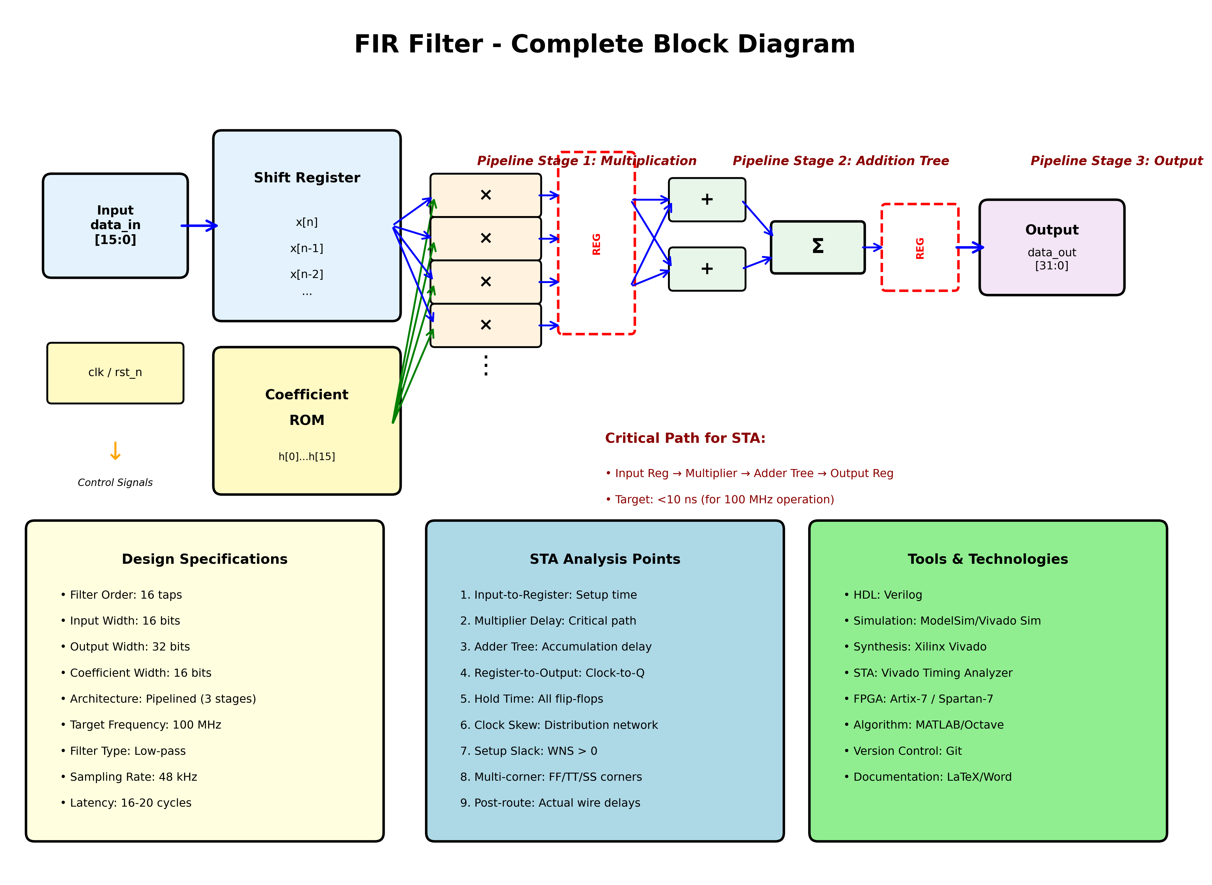

Slide 4
Pain Points
1. HIGH LATENCY
• Software-based filters: 10-50 ms latency
• Requirement: <1 ms for real-time audio (hearing aids)
2. LIMITED THROUGHPUT
• Modern audio needs: 48 kHz - 192 kHz sampling
• Requirement: >100 MSPS (Million Samples Per Second)
3. RESOURCE INEFFICIENCY
• Excessive LUT and DSP block consumption
• Power critical for portable devices
4. TIMING CHALLENGES
• Meeting timing closure at >100 MHz
• Critical path delays in multiply-accumulate operations
• Need: Comprehensive Static Timing Analysis (STA)
5. VERIFICATION COMPLEXITY
• Ensuring functional correctness across all frequencies
• Validating frequency response matches specifications

Slide 5
Objective
1. DESIGN & DEVELOPMENT
✓ Design 16-tap FIR digital filter using Verilog HDL
✓ Implement pipelined architecture for high-speed operation
✓ Target operating frequency: ≥100 MHz
2. STATIC TIMING ANALYSIS (STA)
✓ Perform comprehensive STA
✓ Identify and optimize critical timing paths
✓ Achieve timing closure with positive slack
✓ Analyze setup time, hold time, clock-to-Q delays
3. PERFORMANCE OPTIMIZATION
✓ Minimize latency
✓ Optimize resource
✓ Reduce power
✓ Maximize throughput

Slide 6
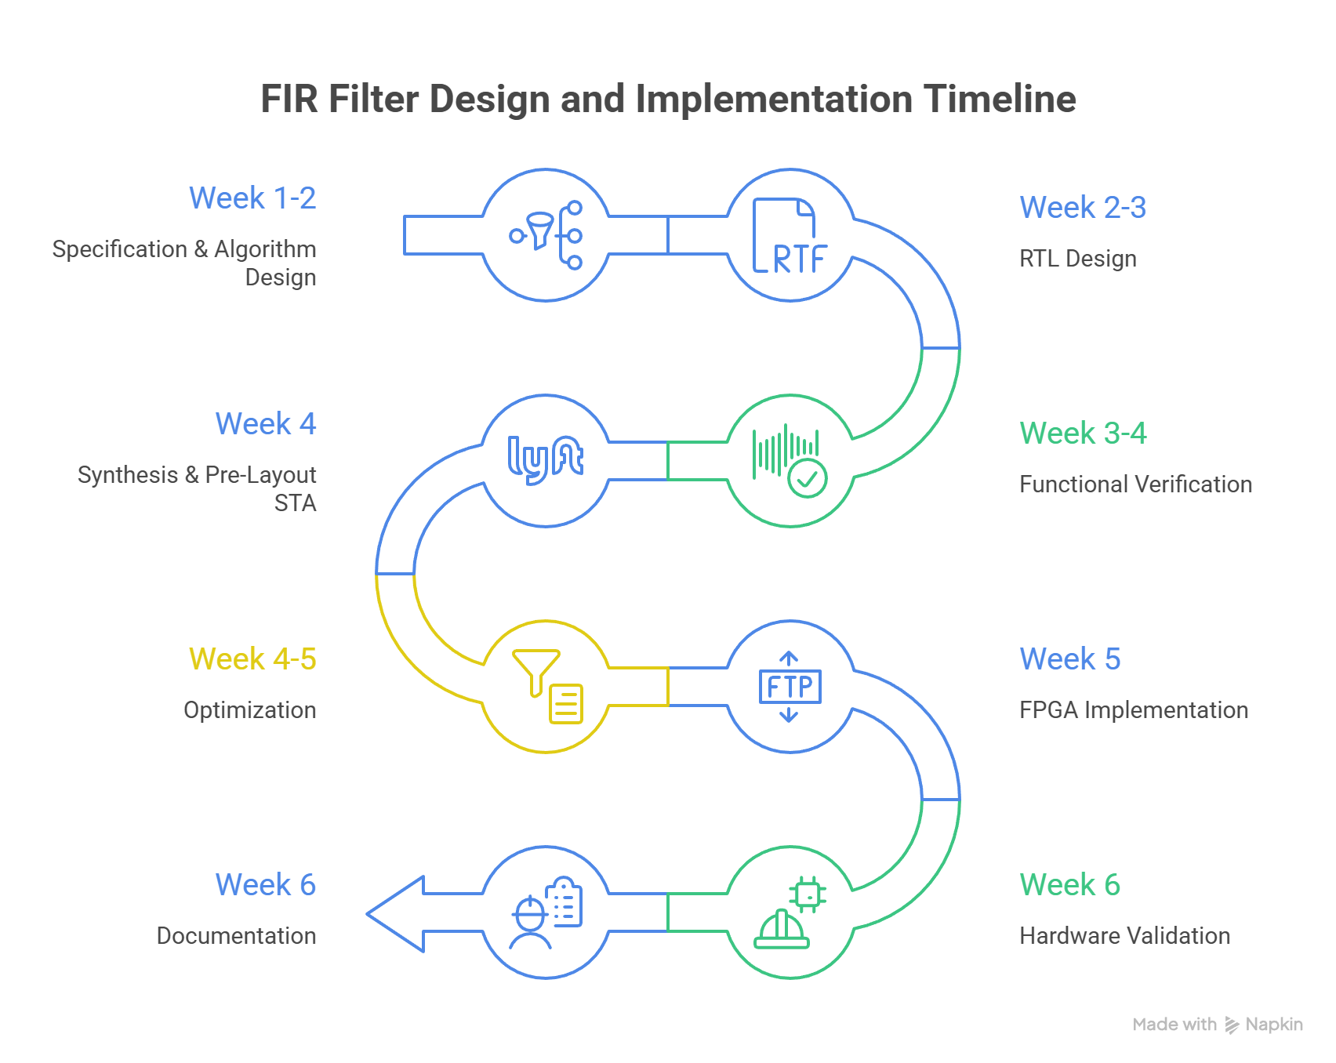
Methodology

